Slide 1

Custom Internship Search on Google Sheets Set Up Tutorial
Presented by:
Murtuza Rajkotwala Research and Business Development Officer
September 25th, 2025

Slide 2
Set Up

Slide 3
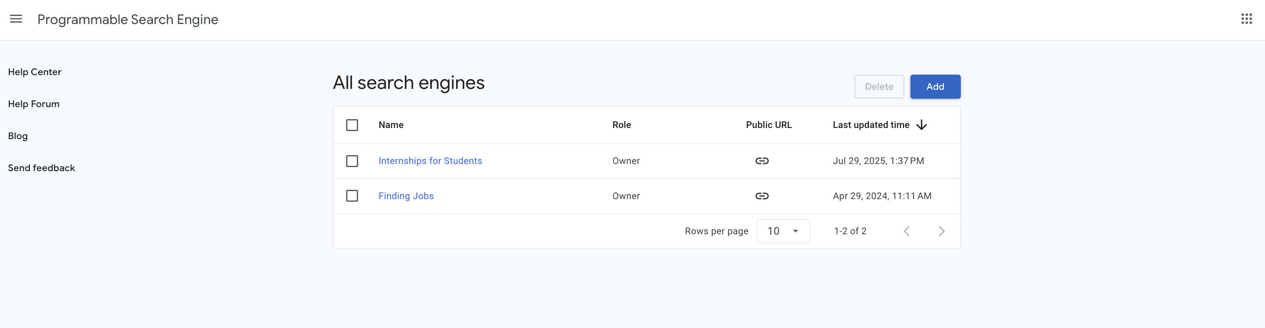
Create a Google Custom Search Engine (CSE)
Go to https://cse.google.com/cse/
Click "Add"

Slide 4
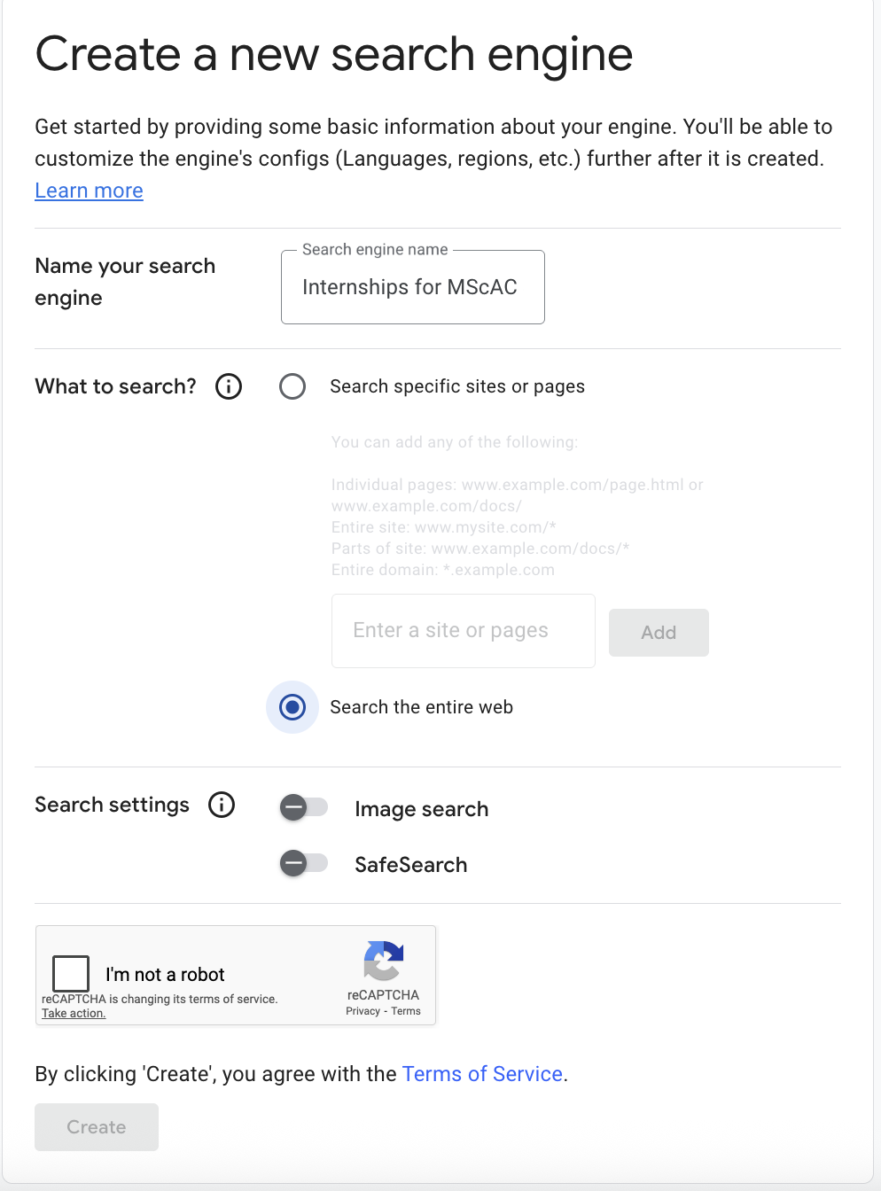
-Name your search engine, select search the entire web then ”Create” below. Click customize after.

Slide 5
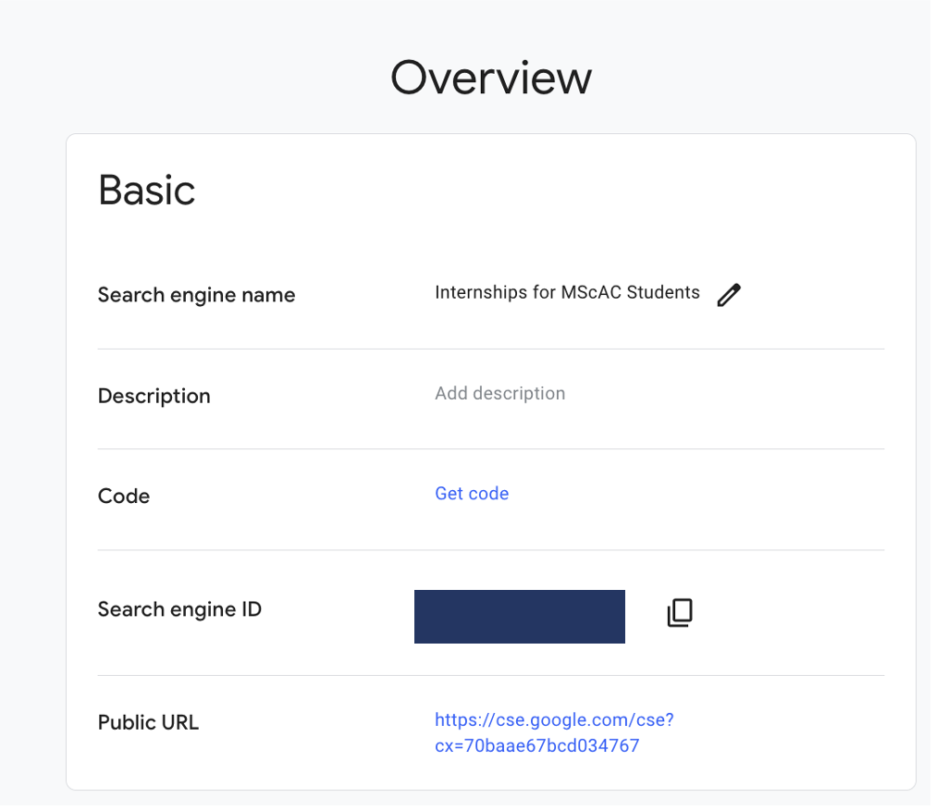
Save your search engine ID, you will need it later.

Slide 6
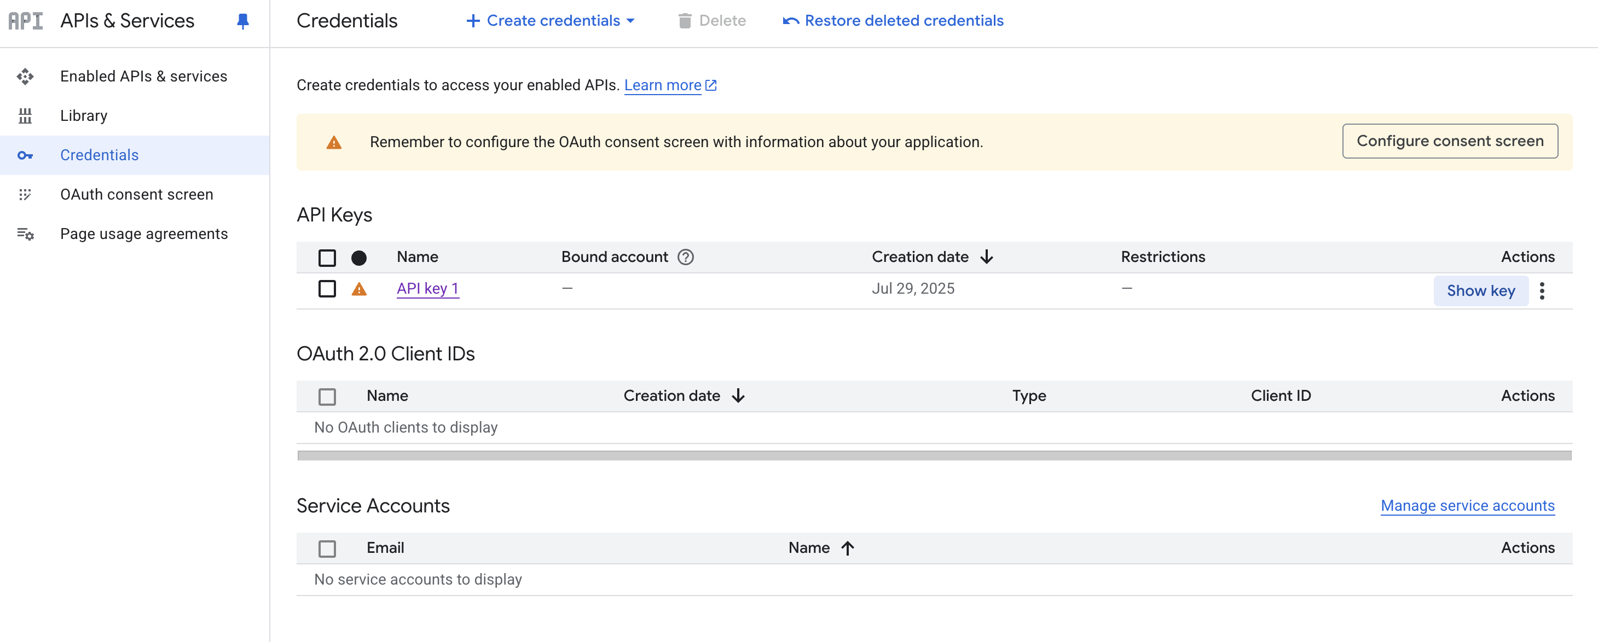
Get your API Key
Go to https://console.cloud.google.com/
Select or create a new project
Navigate to APIs & Services → Credentials
Click "Create Credentials" → "API Key"
Copy your API key by selecting “Show Key”

Slide 7
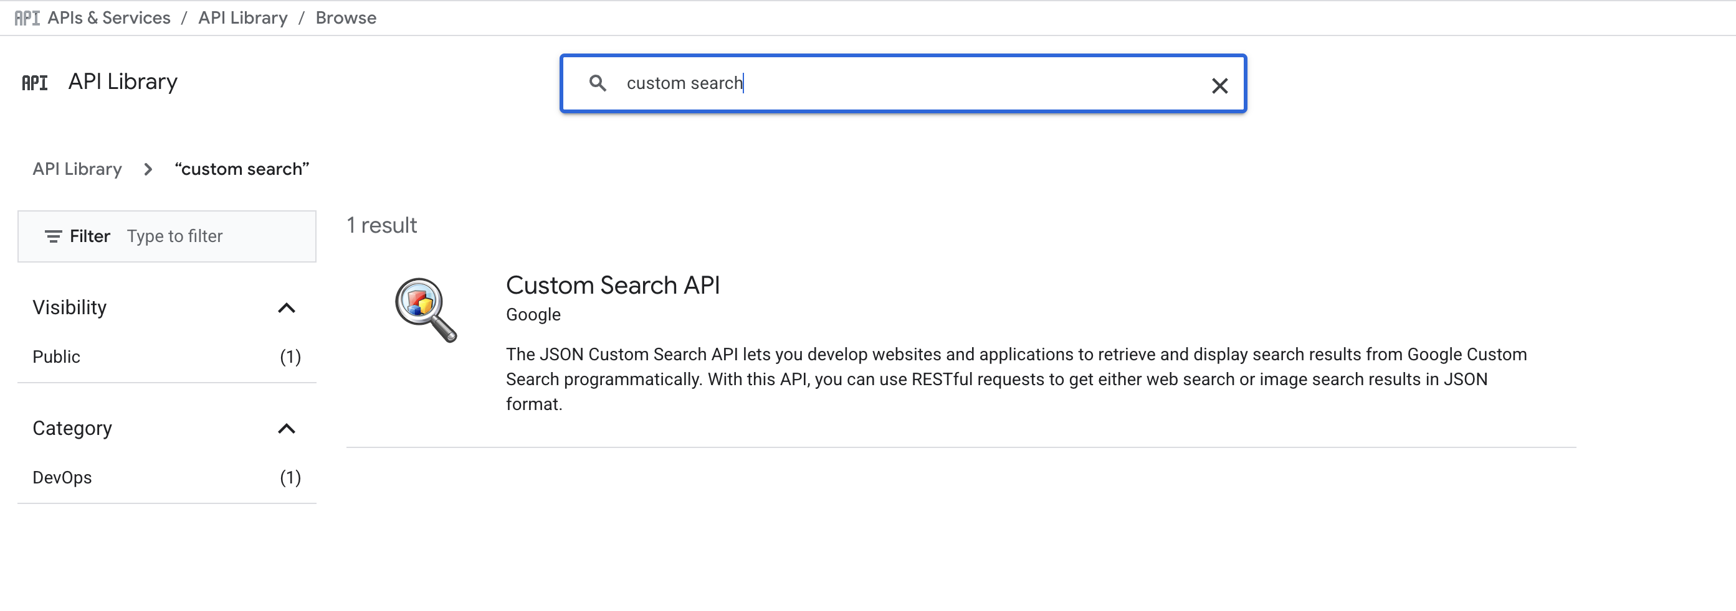
Enable the Custom Search API for your project
In Google Cloud Console, go to APIs & Services → Library
Search for "Custom Search API"
Click Enable

Slide 8
Insert your API Key and Search Engine ID in Script
To do this, you need to open up a new Google Sheet, Extensions > App Script.
From there, paste the web scraping script, found here (https://docs.google.com/document/d/1PV-iVOcmE5Z63kUgfWbVQEc5eThVlusTsP9msOhfGSM/edit?usp=sharing)
Paste the script into your App Script, then change the first two lines of the function. Replace with your API key and your Search Engine Key.
var apiKey = 'YOUR_API_KEY_HERE';
var searchEngineId = 'YOUR_SEARCH_ENGINE_ID_HERE’;
Save the script
Run the function "searchAndSaveResults"
You may be prompted to authorize permissions
Results will be populated into the active sheet

Slide 9
You are all set up!
You can customize your search terms by changing “var searchTerms” to whatever keywords you want. There might be a difference between ”machine learning intern” vs “ML Intern” vs ”ML co-op”.
Very good for finding niche positions and companies you didn’t know hire. Search terms could be locations, subject areas (computer vision, AI, graphic design, music, cybersecurity). Also a good way to evaluate the job market for particular industries.
Try different job boards! For example, UHN and other hospitals use their own careers page that don’t show up on normal job boards.
(site:jobs.smartrecruiters.com/UniversityHealthNetwork) seems to work for UHN jobs. See the pattern in how hospitals market their jobs and see if you can find the core website and test if you can get a google results.

Slide 10
Source and Inspiration
Job boards are not the only place to find work. Here's how to uncover opportunities directly on company sites using Google: Step 1: Craft a Google search. Combine "site:" with ATS URLs and your desired job title. For example, to find "SOC Analyst" roles on Greenhouse-hosted career pages, enter … site:greenhouse.io "SOC Analyst” (remember, you can use any combination of key words related to your target role - not just job title)
Source: Josh Fullmer

Slide 11
Questions? Email: murtuza.rajkotwala@utoronto.ca

